Slide 1
Engineering
Ethics CPD –
online or face to face?
Martin Davies, Head of Digital Learning
The Institution of Engineering & Technology

Slide 2
As companies build the organization
of the future, continuous learning is
critical for business success, and calls
for organisations that can deliver learning
that is always available over a
range of platforms
(2017 Deloitte Global Human Capital Trends)
relevant – personalised – on demand – engaging – recognised

Slide 3
Delivering a compelling, digital learning experience is critical to business success
2017 Deloitte Human Capital Trends research discovered that 83% of CEO’s and HR leaders rate corporate learning as important

Slide 4
However…
Face-to-Face learning still dominates the CPD landscape

Slide 5
The ‘Ethics’ of face-to-face CPD
A quality experience
Trusted learning
The chance of networking
The ability to ask questions
…a day out of the office

Slide 6
Online learning has moved on…
Quality of content has improved massively
Trusted author partners
Experience digital authors and instructional designers
Regular updates
Social Learning is built in to many platforms
Virtual classrooms with assigned SMEs
Self-paced
Content available for extended periods

Slide 7
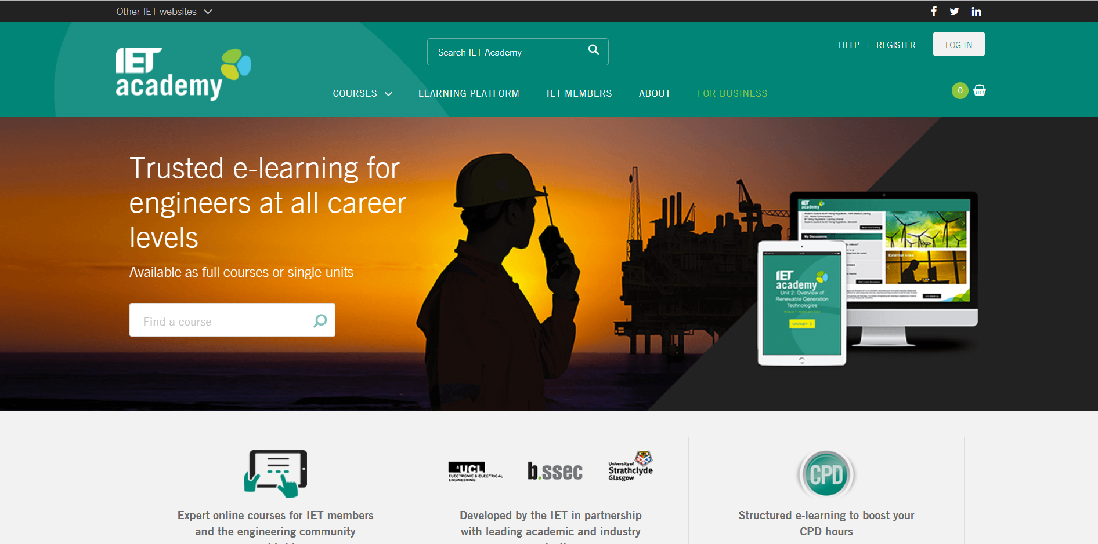

Slide 8
Blended Learning on the rise
Offers the networking experience
Flipped classroom allows meaningful discussion
Face-to-face access to SMEs
Formal certification via invigilated assessment

Slide 9
Conclusions
The training market place is changing
End-users have high expectations
Personalisation is on the increase
Flexibility in delivery is key
Face-to-face CPD will be around for a while yet…

