Slide 1
Mendicant Orders and Literature in Italy (13th-14th Centuries)
4. The Books of Friars
The Dominicans Read Dante: The MS Egerton 943 of the British Library
Anna Pegoretti

Slide 2
Egerton 943 (Eg)
1335-40 ca., Bologna-Padua (?)
parchment; V (paper) + I + ff. 186; in folio (mm 394x265); 2 hands in littera textualis
247 framed miniatures, 3 inhabited initials,
2 diagrams (hell and heaven)
http://www.bl.uk/catalogues/illuminatedmanuscripts/record.asp?MSID=6647&CollID=28&NStart=943

Slide 3
Eg, 117r
http://www.bl.uk/catalogues/illuminatedmanuscripts/ILLUMIN.ASP?Size=mid&IllID=10263

Slide 4
Inferno; Firenze, Biblioteca Medicea Laurenziana, Pluteo 90 sup. 125, f. 1r; Firenze, 14th c. m. (Francesco di Ser Nardo da Barberino)
http://www.danteonline.it/italiano/codici_frames/codici.asp?idcod=263
Medium size
Cursive script
No commentary
Decorative elements just to mark the structure

Slide 5
Large size
Gothic script (littera bononiensis)
Latin commentary
Squared miniatures in the frontispiece
http://www.fitzmuseum.cam.ac.uk/explorer/index.php?qu=Category:illuminated*&oid=178463
Decretum Gratiani; Cambridge, Fitzwilliam Museum, MS 183, f. 1r; Bologna, 1320-1330 ca. (Maestro del B18)

Slide 6
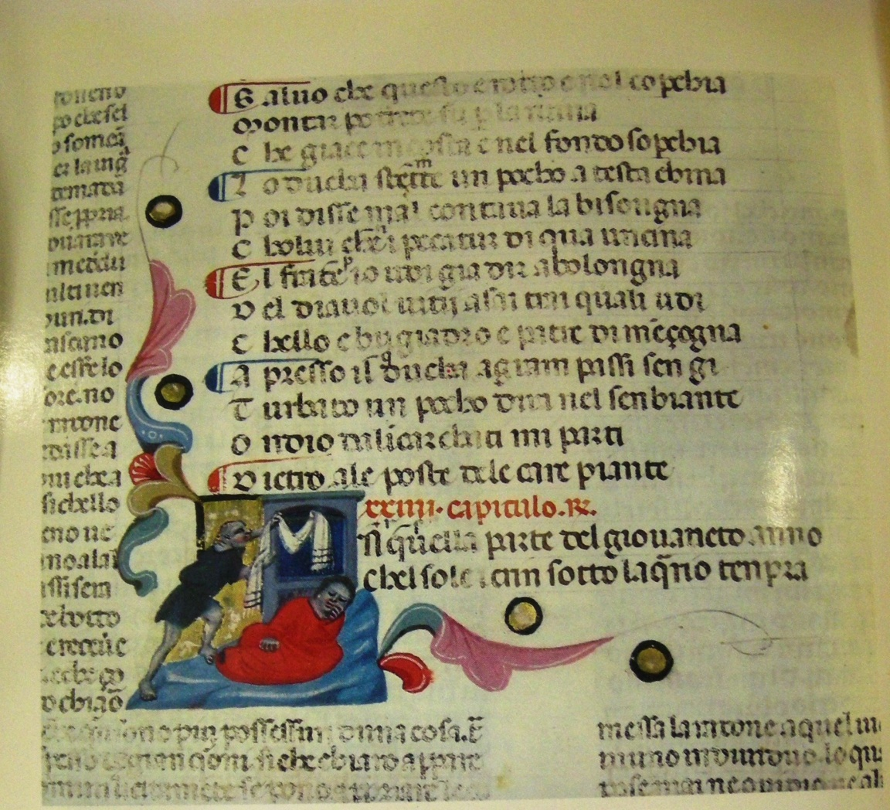
http://www.fitzmuseum.cam.ac.uk/explorer/index.php?qu=Category:illuminated*&oid=178463
Inferno XXIV; Firenze, Bibl. Riccardiana, MS 1005, f. 71r; Bologna (Padova?), 1345 ca. (Illustratore)
Decretum Gratiani; Cambridge, Fitzwilliam Museum, MS 183, f. 1r; Bologna, 1320-1330 ca. (Maestro del B18)

Slide 7
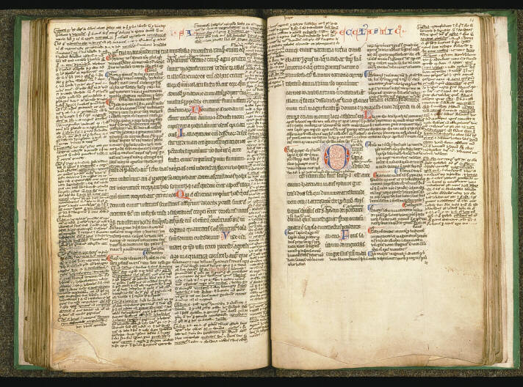
Paris, Bibl. Sainte-Genèvieve, Ms 60, cc. 83v-84, Sirach

Slide 8
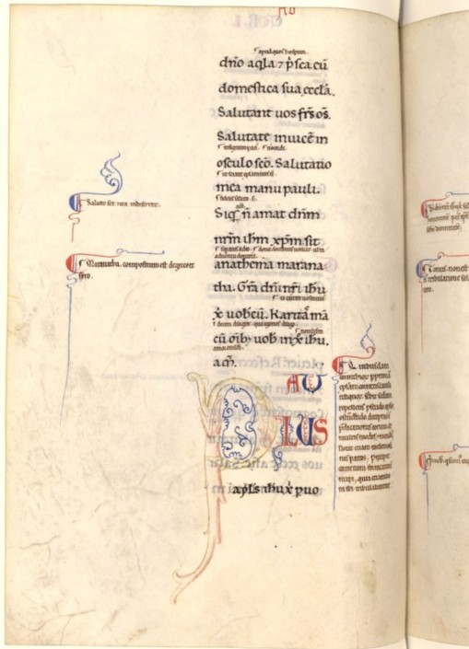
St Paul’s Epistles (“Psalterium Rotomagense”): BnF, lat. 17249, f. 8v; Venezia/Padova, 12th-13th
(Eg, f. 46r)

Slide 9
Eg “libro da banco”
Par. X 22, «or ti riman, lettor, sovra ’l tuo banco»
(now stay there, reader, on your bench)
Large format
Gothic script
Latin commentary

Slide 10
Latin glosses
1st commentary: Lombard Anonymous (Al), by 1326; scattered glosses to Inferno and Purgatorio
2nd commentary: Theologian Anonymous (At), Dominican friar, 1326-1336 circa = Al + new glosses to Inferno (+ commentary to Par. I-XI 68 only in Eg)‏
small hand (α) = Al
Eg
large hand (β) = At

Slide 11
Latin glosses after a new collatio
Al
short version long version
At
+
further glosses mostly written in
the same Dominican circle
Eg

Slide 12
NY*, c. 5v | Eg, c. 6v
lasciate ogne sperança [Inf. 3.9], quia in inferno nulla est redemptio. Hic posset questio fieri de Trayano imperatore, qui fuit tanto tempore in inferno et tamen postea, ad preces Gregorij, exivit. * New York, Pierpont Morgan Library, M 405 | Lasciate etc. [Inf. 3.9] Quia in inferno nulla est redemptio. Hic posset fieri questi<o> de Traiano, qui fuit tanto tempore in inferno et tamen postea, ad preces Gregorij, exivit. Hanc questionem insolutam dimitto, ut etiam alij habeant aliquod dicere.
I leave this problem unsolved, so that also others could say something

Slide 13
1335 – Roman Province
Item ut fratres nostri ordinis theologie studio plus intendant, […] prohibemus districte fratribus universis iunioribus et antiquis quatenus poeticos libros sive libellos per illum qui Dante nominatur in vulgari compositos nec tenere vel in eis studere audeant. Contrarium facientes, cum ad prelatos eorum pervenerit, volumus libris predictis ex vi presentis statuti privari, mandantes prelatis eisdem quod si qui ordinationis huiusmodi inventi fuerint trasgressores, sine mora priori provinciali studeant nuntiare | In order that our friars would devote themselves more to the study of theology, we strictly forbid all the friars – both young and elder – that they keep or dare to read those poetic books or little books written in vernacular by that one who is called Dante. Those who will do the contrary, in the case that their superiors would know it, we want that they will be deprived of those aforementioned books according to the present rule; we also prescribe the superiors to report immediately to the provincial prior if they find anyone violating the rule [my trans.]
Acta capitulorum provincialium provinciae romanae (1243-1344), ed. T. Kaeppeli e
A. Dondaine, Roma, Istituto Storico dei Frati Predicatori in S. Sabina, 1941, pp. 286-288

Slide 14
O.P. Constitutiones antiquae, I.28
[studentes] in libris gentilium et philosophorum non studeant […]. Seculares scientias non addiscant, nec etiam artes quas liberales vocent, sed tantum libros theologicos tam iuvenes quam alii legant | [students] shall not study either pagan or philosophers’ books […]. They shall not learn either secular sciences, or those arts that are called liberal; instead, they – both young students and the others – shall read exclusively theological books [my trans.]

Slide 15
Corpus Iuris Canonici, I. Decretum Gratiani, dist. XXXVII
seculares litteras quidam legunt ad voluptatem, poetarum figmentis et verborum ornatu delectati; quidam vero ad eruditionem eas addiscunt, ut errores gentilium legendo detestantur, et utilia, que in eis invenerint, ad usum sacrae eruditionis devote invertant (ch. 8, part 2) | somebody reads lay literature with great pleasure, delighted by poets’ images and by the decorated beauty of words; somebody else studies it for the sake of knowledge, to hate pagans’ mistakes, and to learn the useful things that they find there, in order to devotedly transfer them in their knowledge of sacred things [my transl.]

Slide 16
Eg, 124r
http://www.bl.uk/catalogues/illuminatedmanuscripts/ILLUMIN.ASP?Size=mid&IllID=10458

Slide 17
Par. 1.4-5, “nel ciel che più de la sua luce prende / fu’ io” (In the heaven that receives most of his light have I been)
dicit quod fuit ibi: loquitur sicut poeta, de quibus dicit beatus Augustinus quod licitum fuit eis fingere ut per tales circumlocutiones* cicius possent homines a vitiis retrahere et ad virtutes perfectius inclinare (Eg, 129r). | [the author] says that he has been there: he speaks as a poet, about whom St Augustine says that they [poets] are allowed to make pretences, in order to exploit this rhetorical fictions to move men away from vices and make them approch virtues more quickly [my transl.].
*circumlocutiones = periphrasis; more broadly, a whole story

Slide 18
Eg, f. 3r
Inf. 1.1 ff.
http://www.fitzmuseum.cam.ac.uk/explorer/index.php?qu=Category:illuminated*&oid=178463

